Slide 1
BEM-FMM in Python: Up and Running in 10 Minutes
Repository: github.com/BEM-FMM-Team/bem-fmm-python
Derek A. Drumm, Guillermo Núñez Ponasso,
Shawn Pande, Simon Hao
Department of Electrical & Computer Engineering
Worcester Polytechnic Institute
08/01/26
1R01MH130490
1R01EB035484

Slide 2




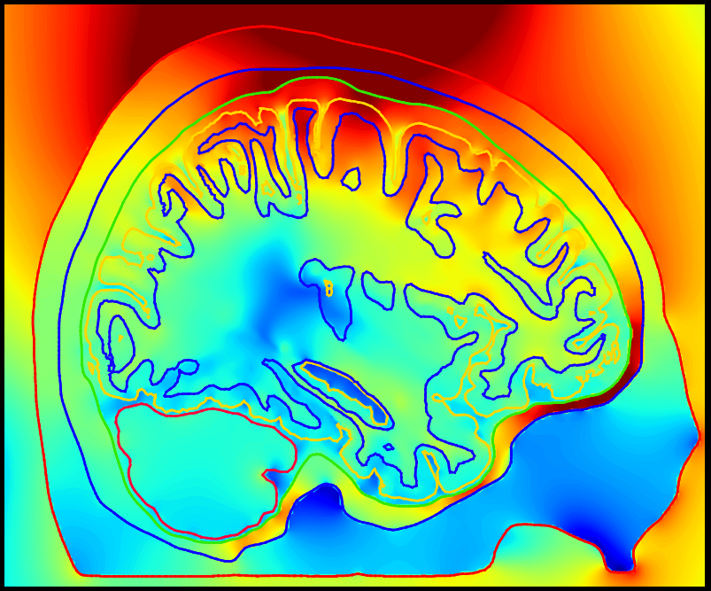
The Team:
Repository: github.com/BEM-FMM-Team/bem-fmm-python

Slide 3
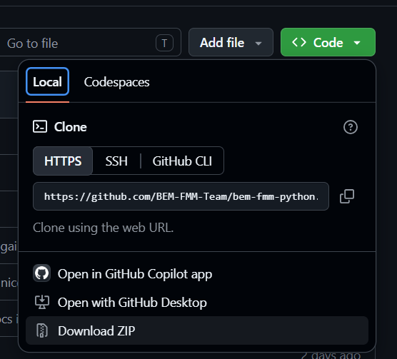
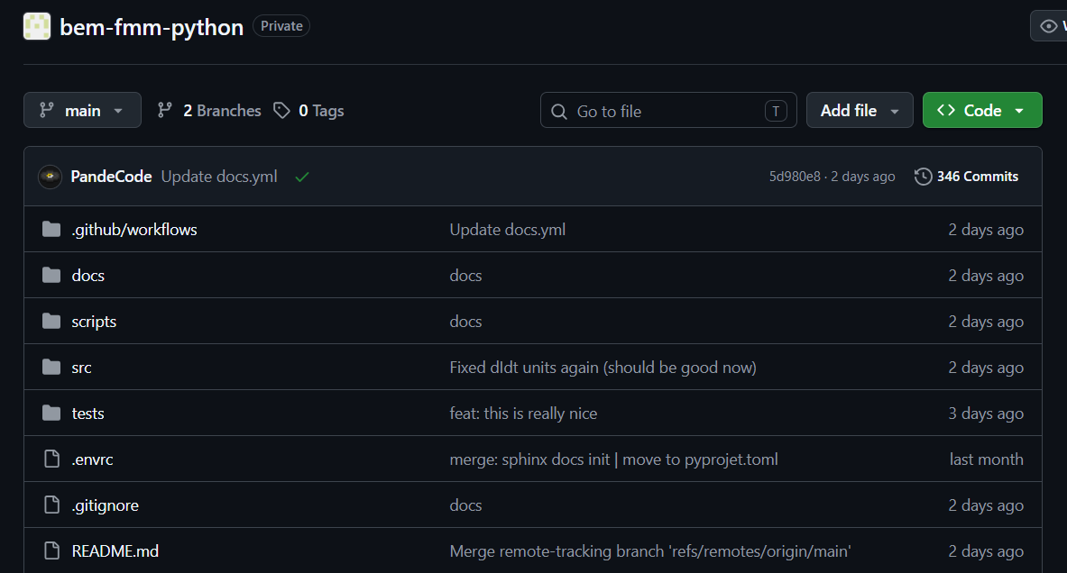
Downloading the Repository:
Repository: github.com/BEM-FMM-Team/bem-fmm-python
***Requirement: You will need Python 3.11+ installed!***
The repository may be obtained on GitHub: github.com/BEM-FMM-Team/bem-fmm-python
The repository can be cloned via git
or downloaded directly
(be sure to Extract the download folder)!
git clone https://github.com/BEM-FMM-Team/bem-fmm-python.git

Slide 4
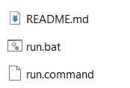
Getting Started:
Repository: github.com/BEM-FMM-Team/bem-fmm-python
You can now start playing around with the TMS navigator:
Windows (most stable):
Execute the “run.bat” file.
Mac (may be unstable):
Execute the “run.command” file.
Linux:
You will need to install uv and ensure it is on the $PATH.
Then run “run.command” or proceed with Nix (there is a devShell which will place you in an isolated environment to run everything).
Note: All dependencies should be downloaded and installed automatically.
→ Depending on your machine, this can take upwards of 5 minutes!

Slide 5
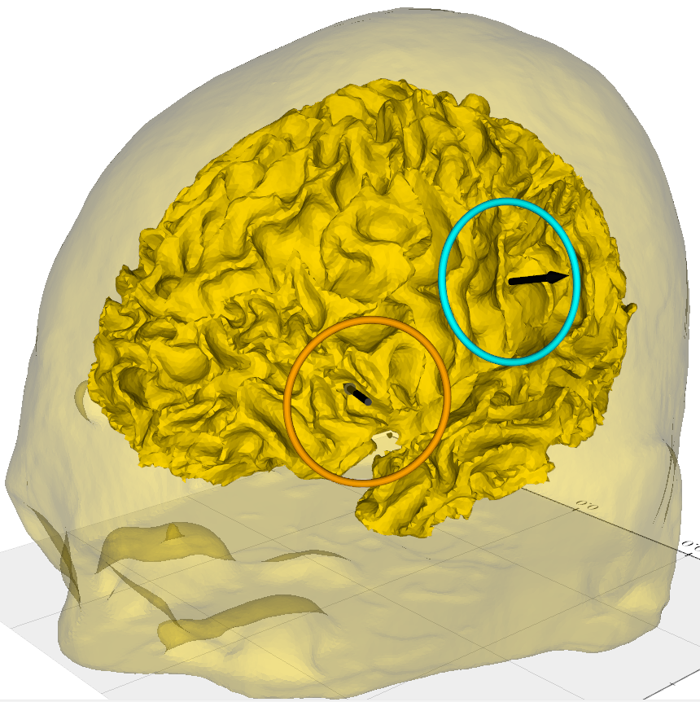
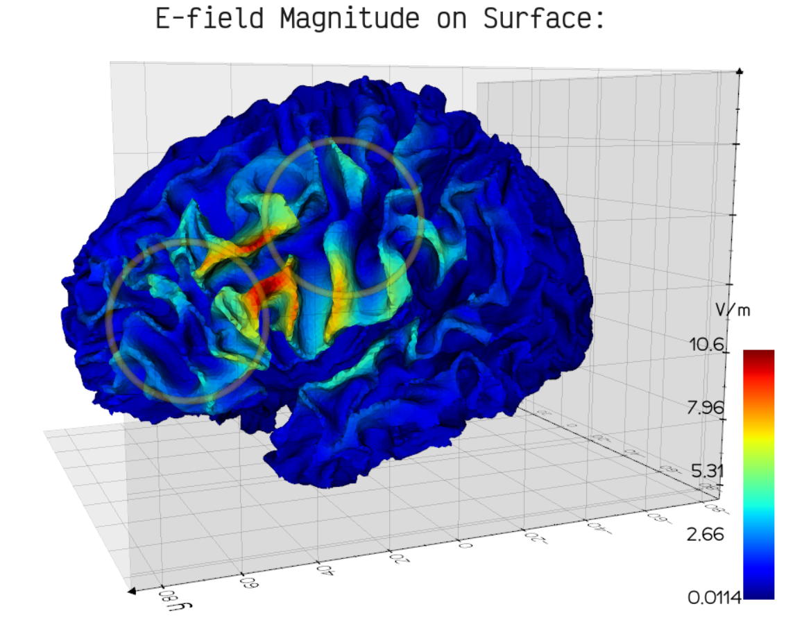
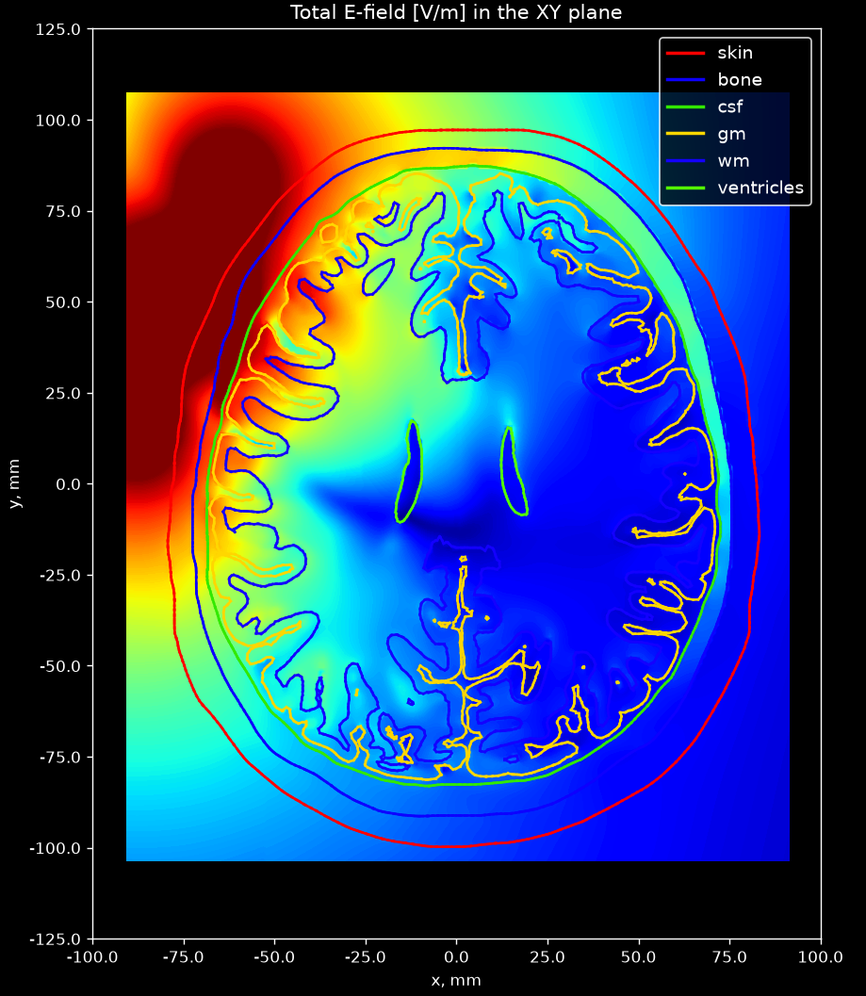
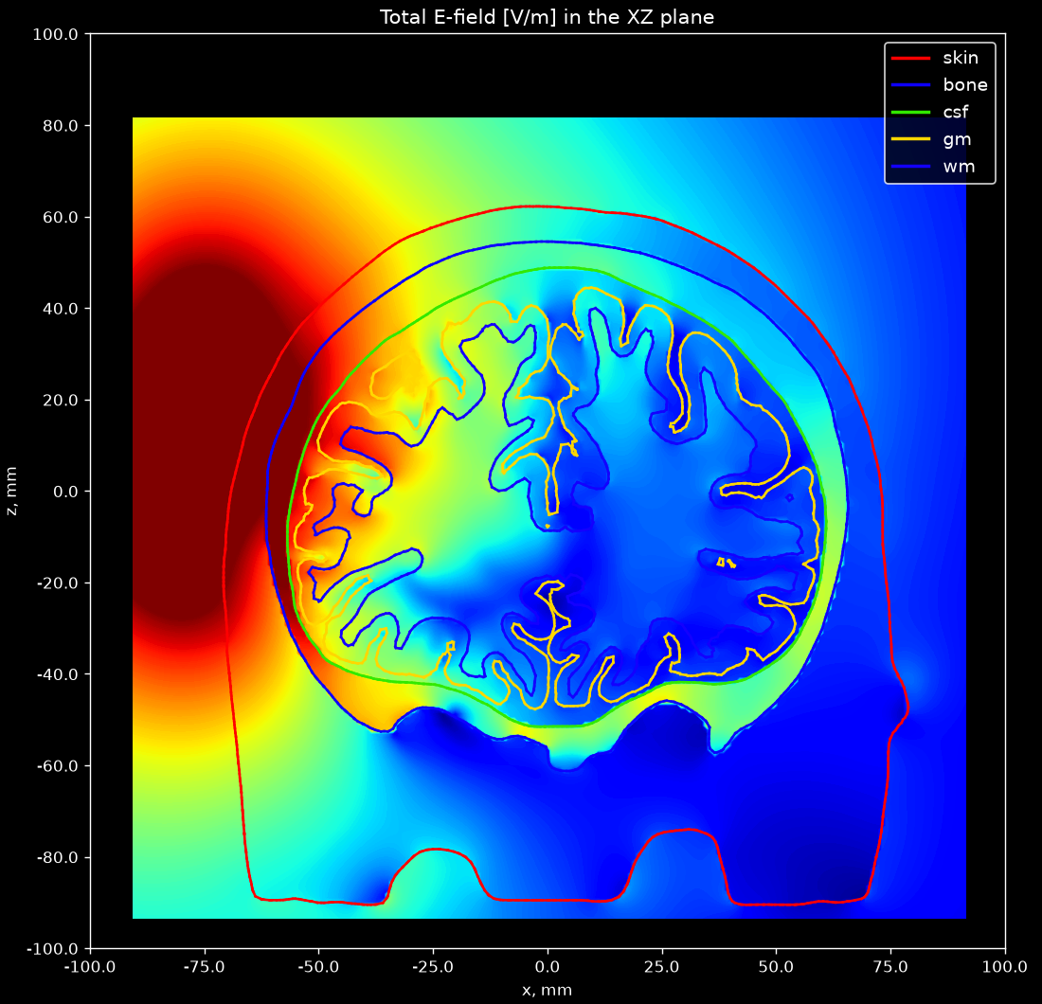
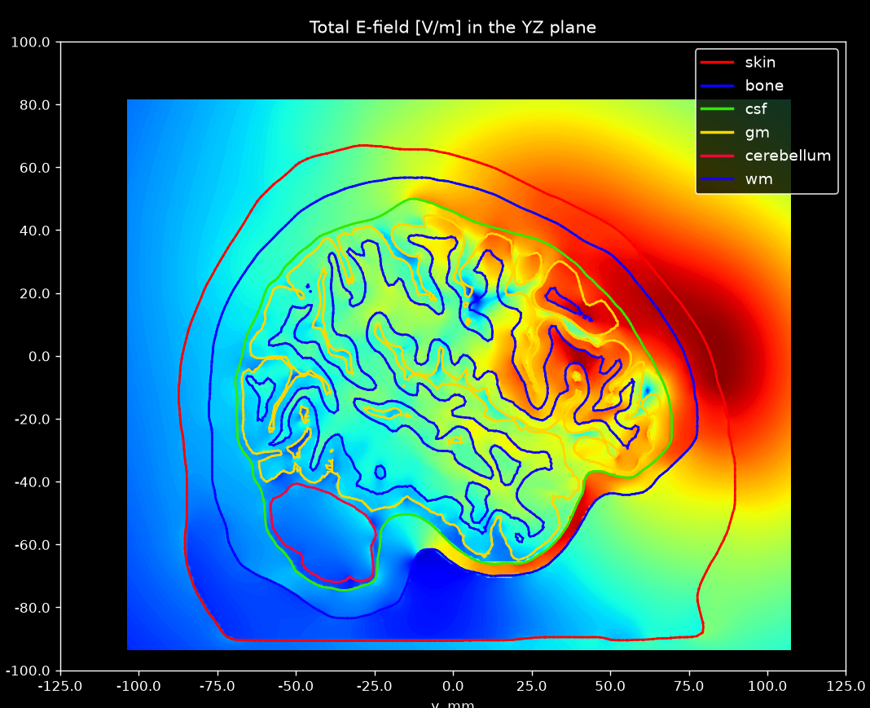
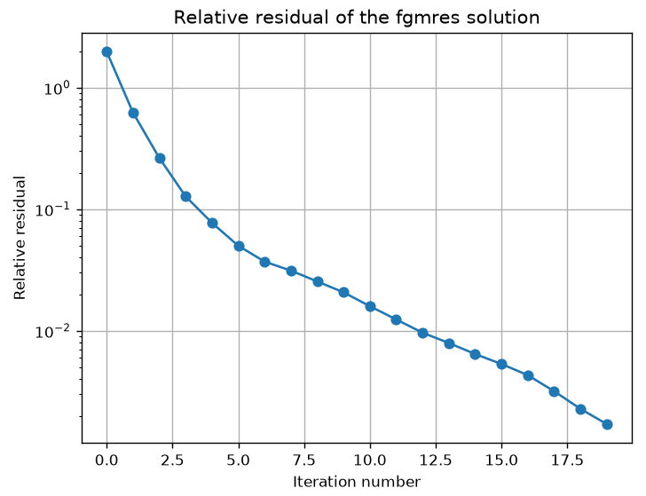
What to Expect:
Repository: github.com/BEM-FMM-Team/bem-fmm-python

Slide 6
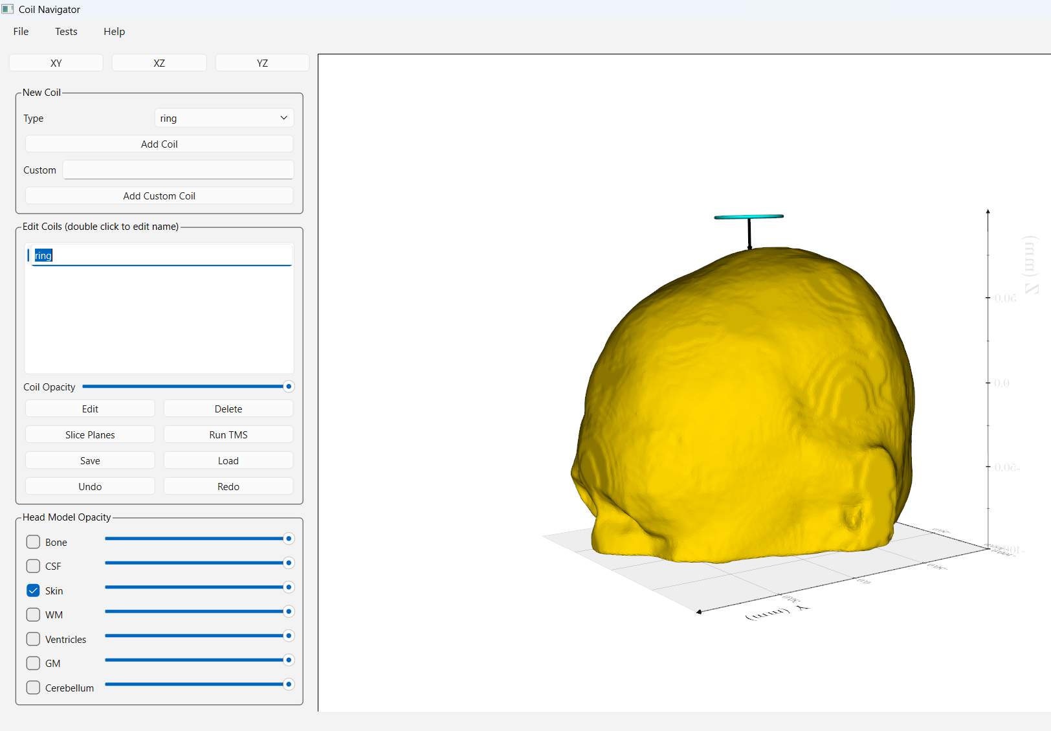
Setting Up a TMS Coil
Repository: github.com/BEM-FMM-Team/bem-fmm-python
Once the navigator has loaded, we can begin by adding a coil.
1) Click “Add Coil” and then click “Ok” to add a ring coil.
* You may double click on the name to rename the coil.
2) Click “Edit” to begin modifying the coil position and orientation.

Slide 7
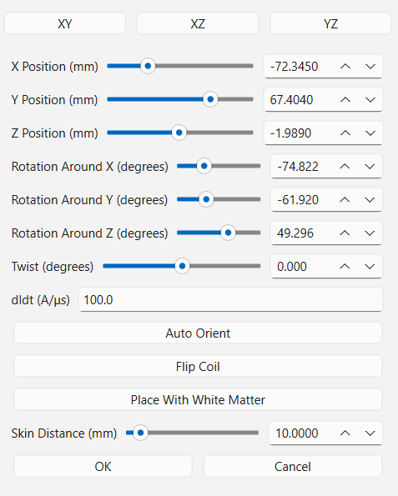
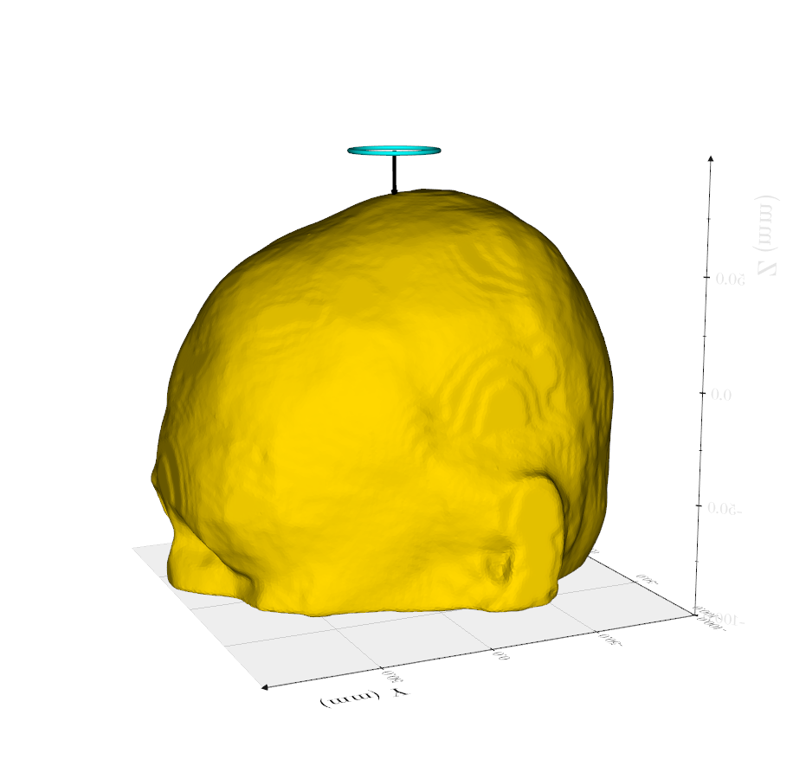
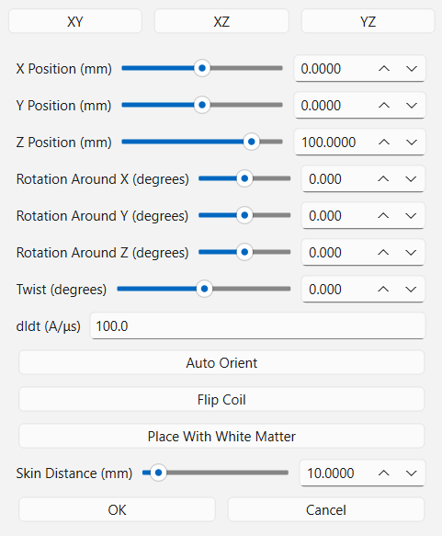
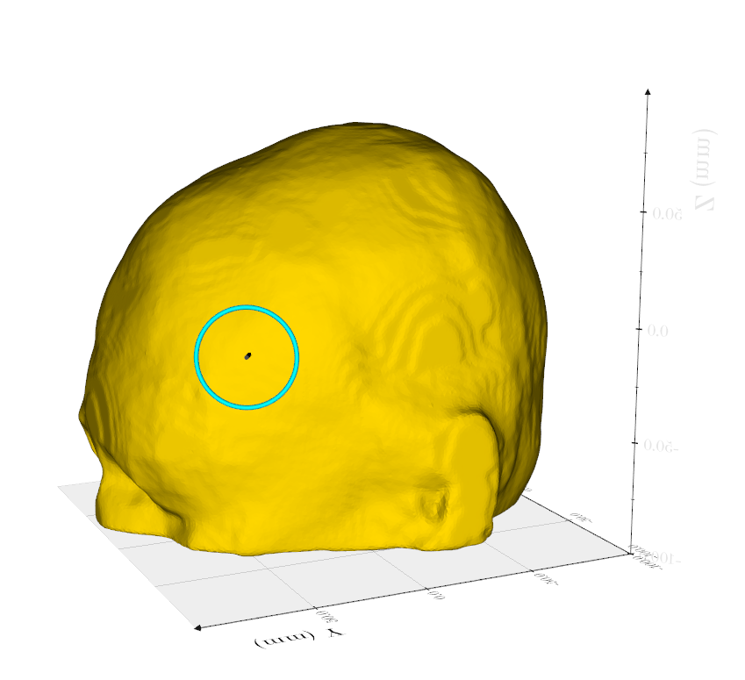
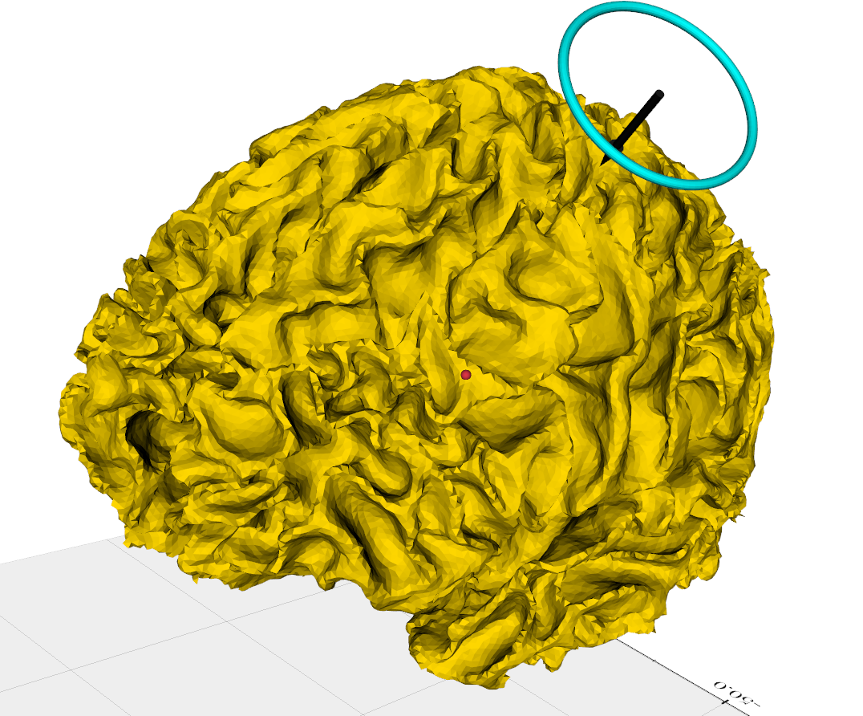
Setting Up a TMS Coil
Repository: github.com/BEM-FMM-Team/bem-fmm-python
There are 3 ways to modify the coil position:
You can manually type the coil position (center of mass) and orientation.
You can click the coil and it will follow your cursor. Click it again to place the coil.
You can click “Place With White Matter” to select a target position on the white matter surface. Click “Apply” to automatically move the coil.

Slide 8
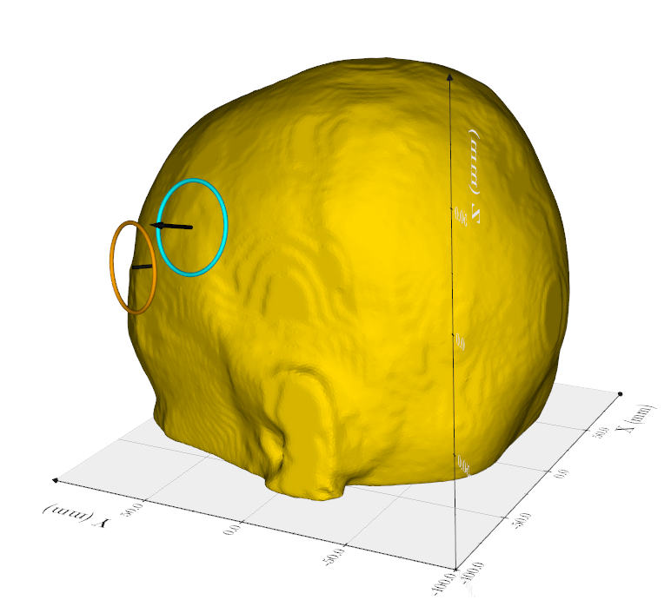
Setting Up a TMS Coil
Repository: github.com/BEM-FMM-Team/bem-fmm-python
We can add a second ring coil. Click “Add Coil” and click “Ok”. Click “Edit” to edit the coil position.
Move the coil near the first ring. Click “Flip Coil” to switch the coil orientation.
*We need the orientation flipped to avoid negative interference of the induced fields.

Slide 9
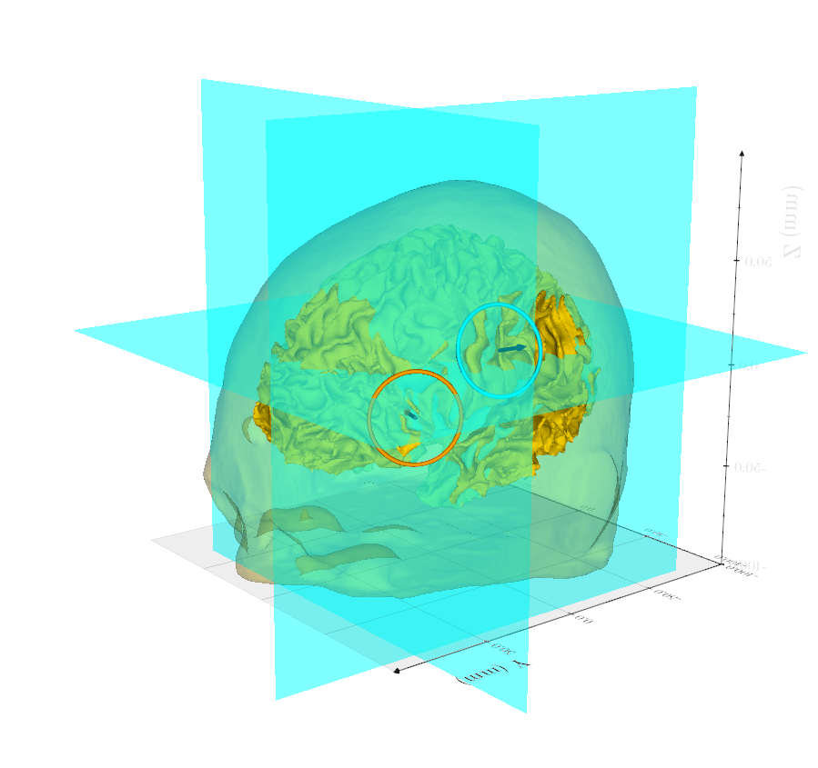
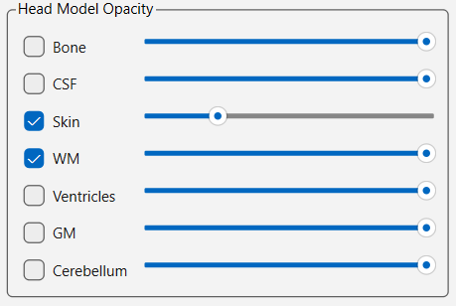
Setting Up Slice Planes
Repository: github.com/BEM-FMM-Team/bem-fmm-python
We can select slice planes to compute the total electric field over.
In the “Head Model Opacity” box, check the “WM” box. Then reduce the opacity of the “Skin”.
Click “Slice Planes”. Use the sliders to put the slice planes in your desired positions.
*You can rotate the head model by clicking and dragging in the plot window. You may also click the coordinate views at the top.

Slide 10
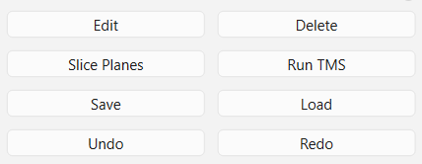
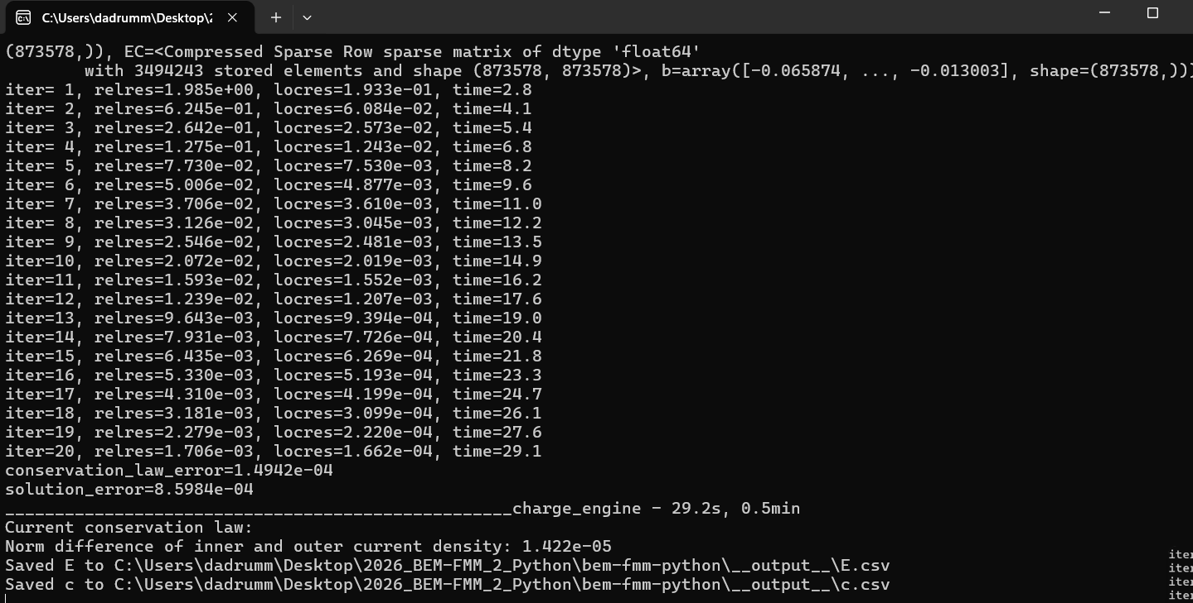
Saving and Running the TMS Solver
Repository: github.com/BEM-FMM-Team/bem-fmm-python
Click “Save” to save the coil configuration file.
Then, click “Run TMS” and select the coil configuration file you just saved.
You may select how the data is saved, if desired. Click “Ok”.
A command window will open and the TMS solver will automatically begin.

Slide 11
The Results:
Repository: github.com/BEM-FMM-Team/bem-fmm-python

Slide 12
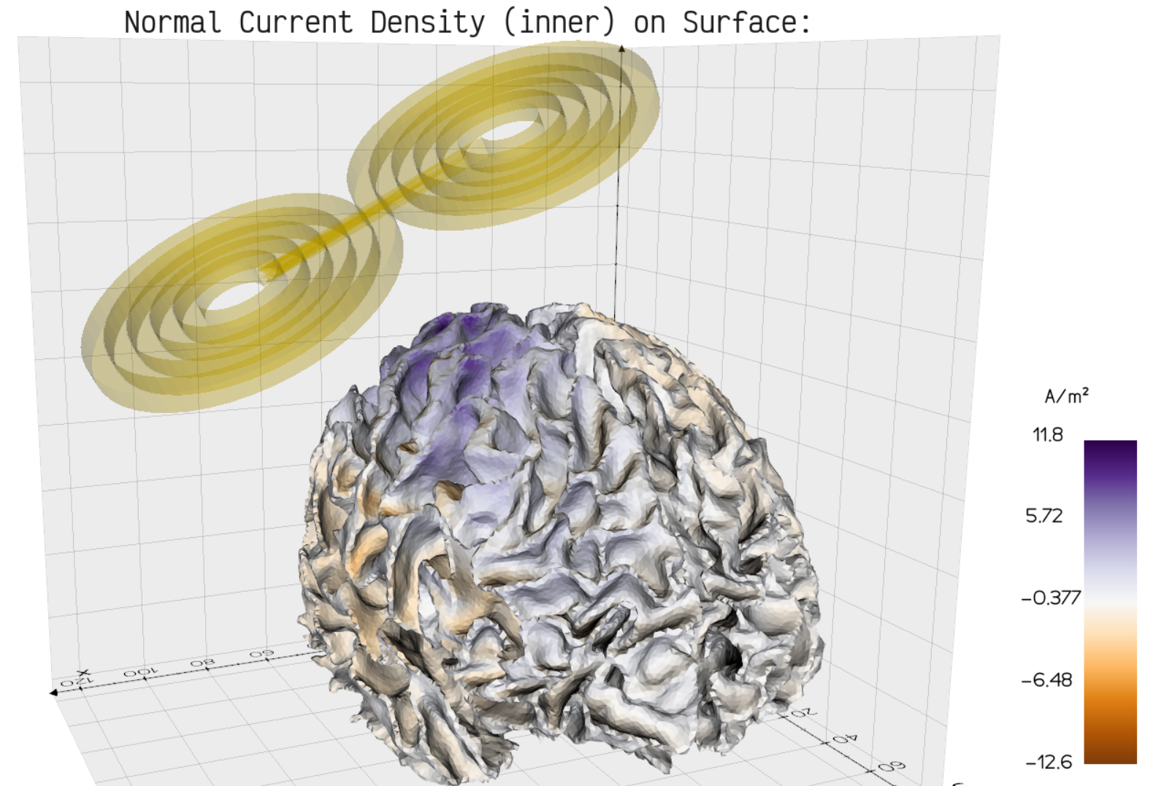
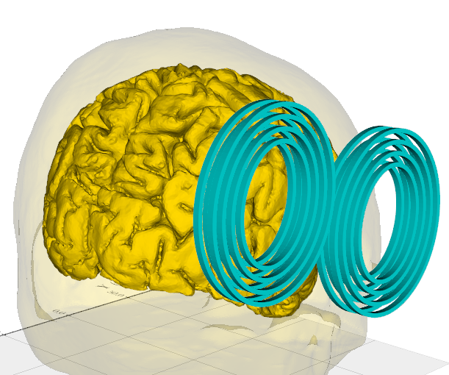
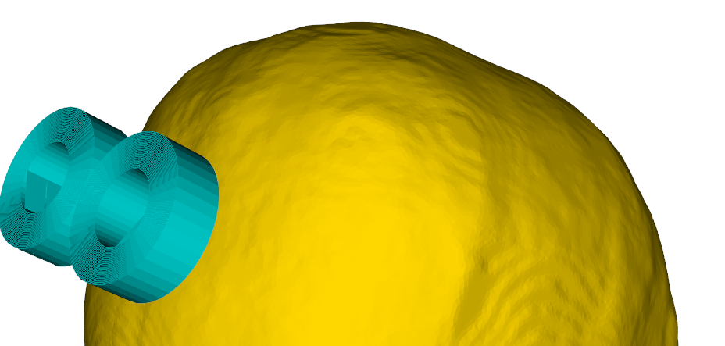
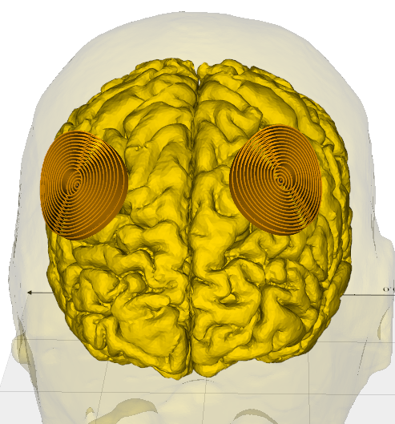
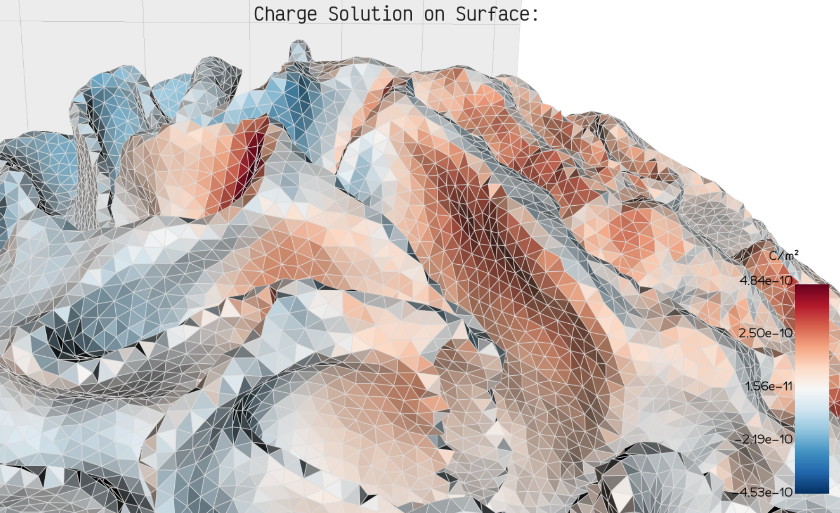
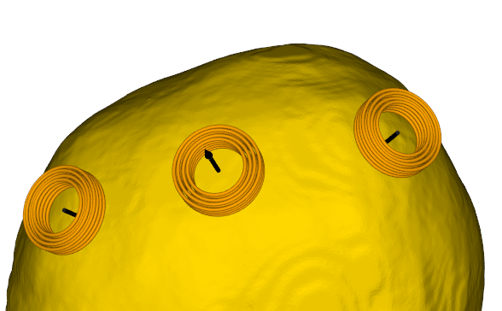
Additional Features
Repository: github.com/BEM-FMM-Team/bem-fmm-python
There are various coils and other features that you can mess around with!

Slide 13
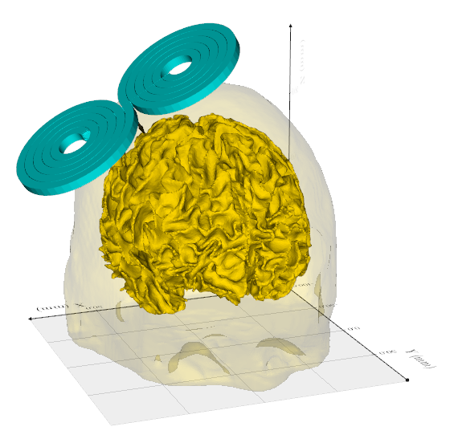
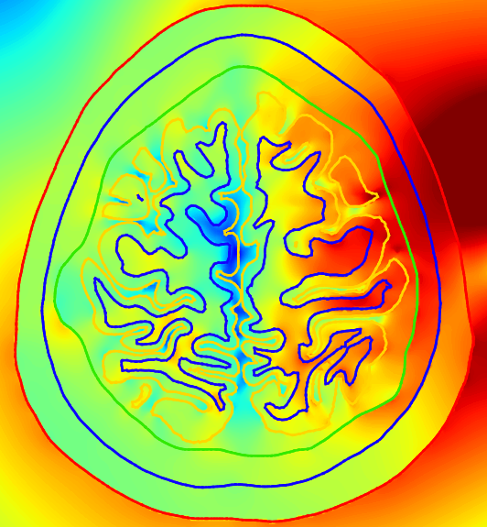
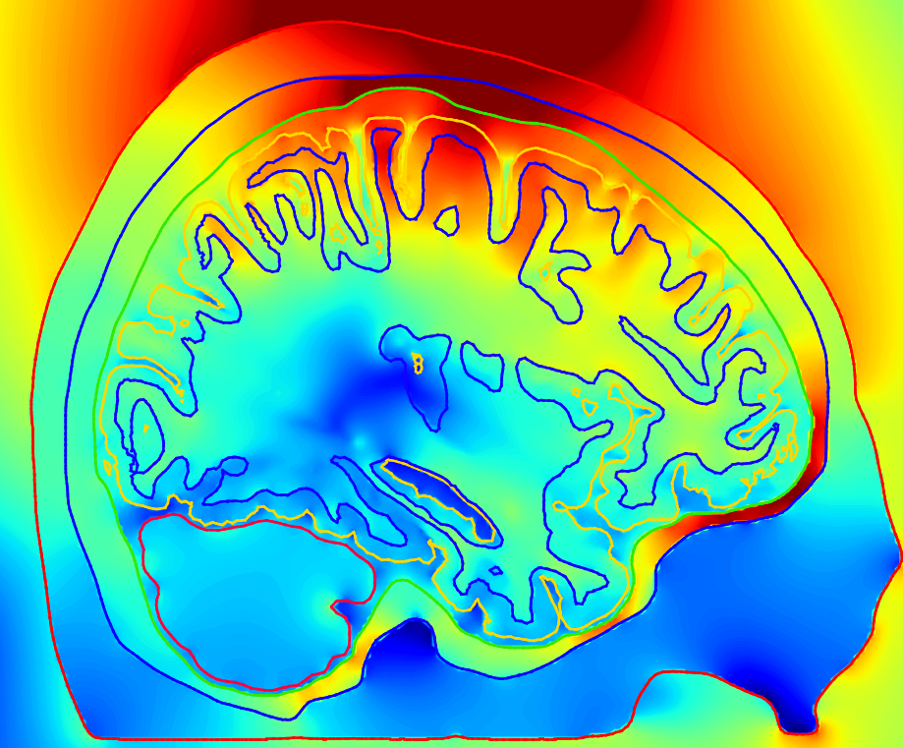
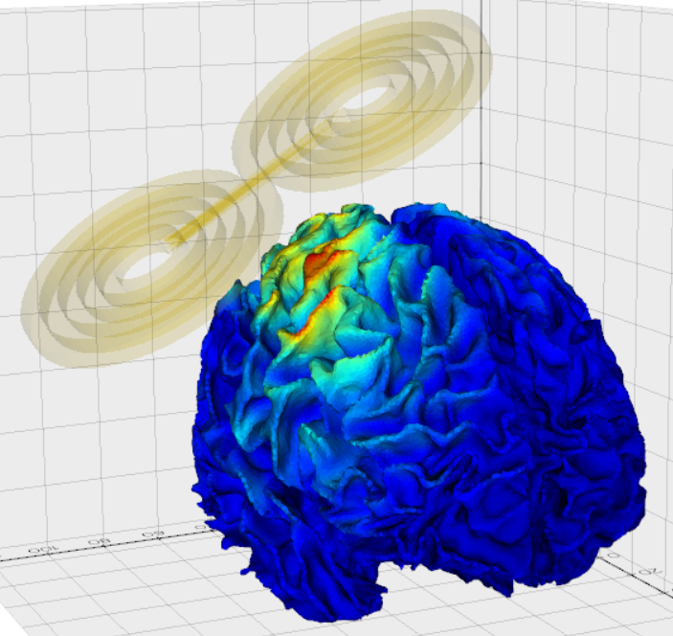
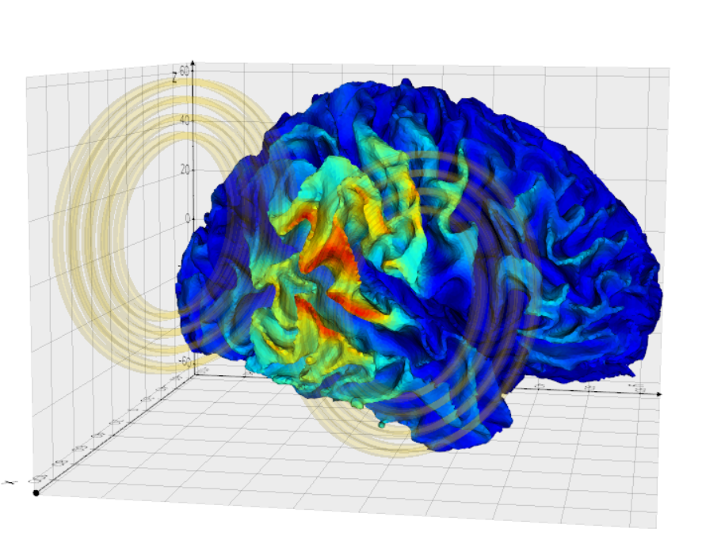
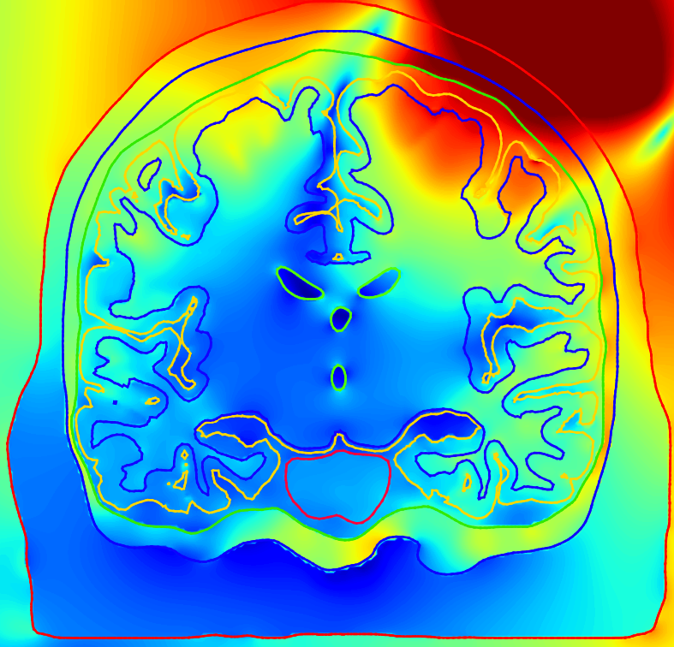
Thank You!
Repository: github.com/BEM-FMM-Team/bem-fmm-python

